Slide 1
Chapter -1
Machine Learning
Today Machine Learning is one of the most exciting technologies. Machine learning is a branch of artificial intelligence (AI) focused on building applications that learn from data and improve their accuracy over time without being explicit programmed. Machine learning is programming computers to optimize a performance criterion using example data or past experience. Machine Learning is a program that analyses data and learns to predict the outcome.

Slide 2
Chapter -1
Applications of Machine Learning
Email spam detection
Face detection and matching (e.g., iPhone X)
Web search (e.g., DuckDuckGo, Bing, Google)
Sports predictions
Post office (e.g., sorting letters by zip codes)
ATMs (e.g., reading checks)
Credit card fraud • Stock predictions
Smart assistants (Apple Siri, Amazon Alexa, . . . )
Product recommendations (e.g., Netflix, Amazon)
Self-driving cars (e.g., Uber, Tesla)
Language translation (Google translate)
Sentiment analysis
Drug design
Medical diagnoses

Slide 3

Chapter -1
What is Machine Learning
The answer is, in one word, algorithms.
Machine learning is, more or less, a way for computers to learn things without being specifically programmed. But how does that actually happen?
Algorithms are sets of rules that a computer is able to follow.
Think about how you learned to do long division -- maybe you
learned to take the denominator and divide it into the first digits
of the numerator, then subtracting the subtotal and continuing
with the next digits until you were left with a remainder.
Well, that’s an algorithm, and it’s the sort of thing we can program
into a computer, which can perform these sorts of calculations much,
much faster than we can.

Slide 4
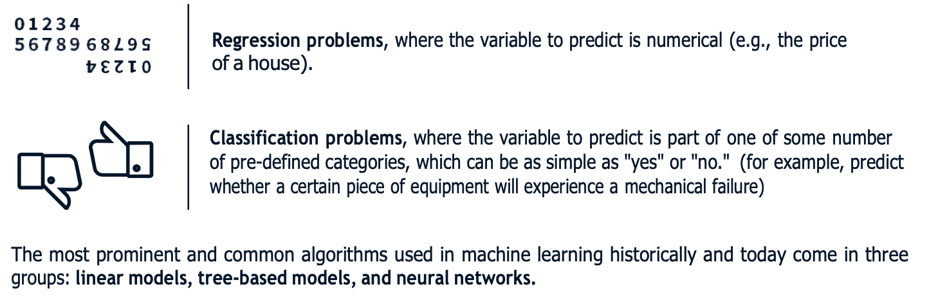
Chapter -1
What does machine learning look like?
In machine learning, our goal is either prediction or clustering. Prediction is a process where, from a set of input variables, we estimate the value of an output variable. For example, using a set of characteristics of a house, we can predict its sale price. Prediction problems are divided into two main categories:

Slide 5
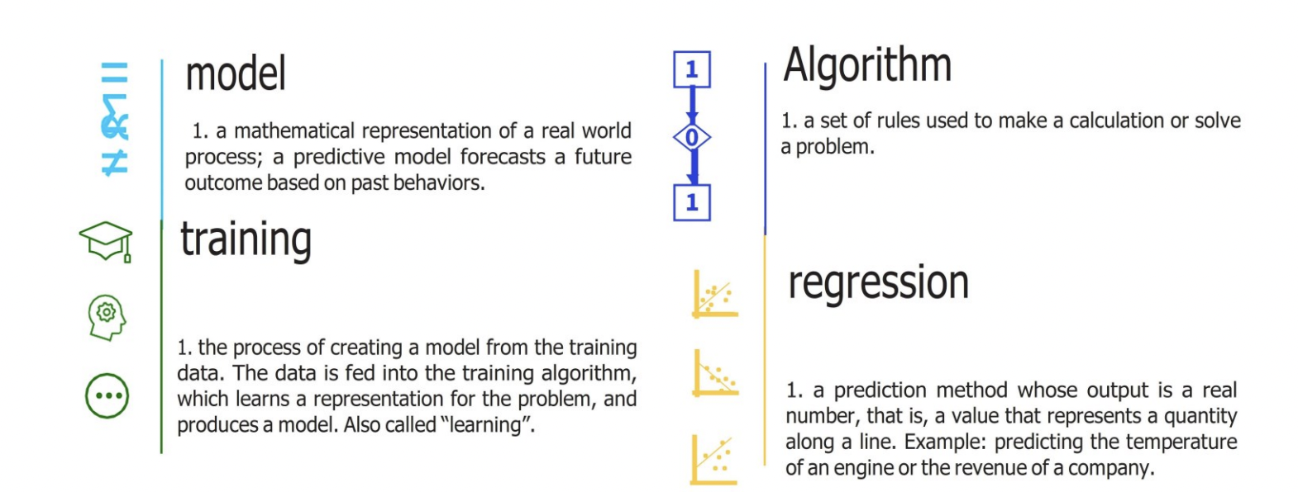
Chapter -2
Fundamental Terms For Machine Learning.

Slide 6
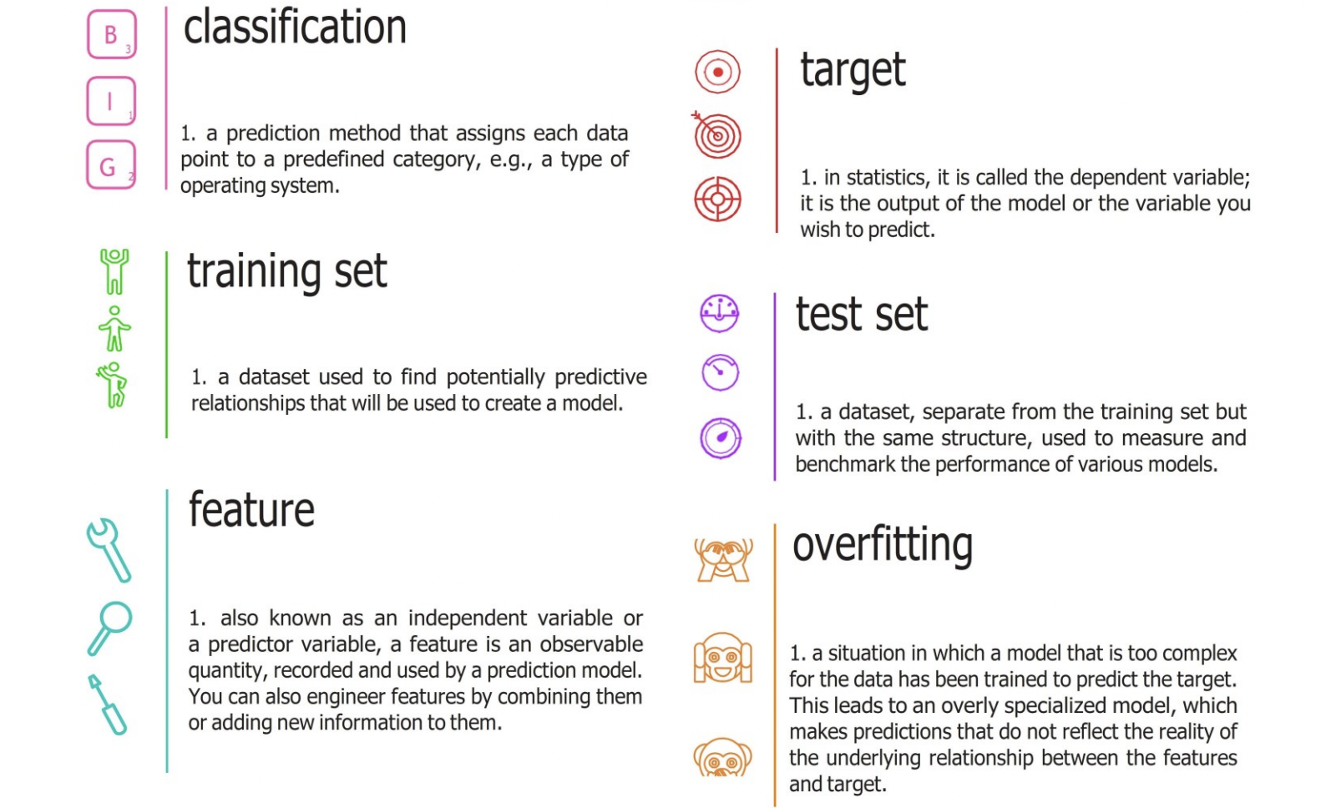
Chapter -2

Slide 7
Chapter -3
Types of Machine Learning
Supervised Learning
Labelled Data
Direct Feedback
Unsupervised Learning
No Labels/Targets
Reinforcement Learning
Decision Process
Reward System
Predict Outcome
No Feedback
Find Hidden Structure in Data
Learn Series of Actions

Slide 8
Chapter -3
Supervised Learning
Supervised learning, also known as supervised machine learning, is a subcategory of machine learning artificial intelligence. It is defined by its use of labeled datasets to train algorithms that to classify data or pre outcomes accurately.
One practical example of supervised learning problems is predicting house prices. How is this achieved? First, need data about the houses: square footage, number of rooms, features, whether a house has a garden or not, so on. We then need to know the prices of these houses, i.e. the corresponding labels
The goal of supervised learning is to build an artificial system that can learn the mapping between the input the output, and can predict the output of the system given new inputs.
learning from labeled training data (i.e., inputs that also contain the desired outputs or targets; basically, “examples what we want to predict).

Slide 9
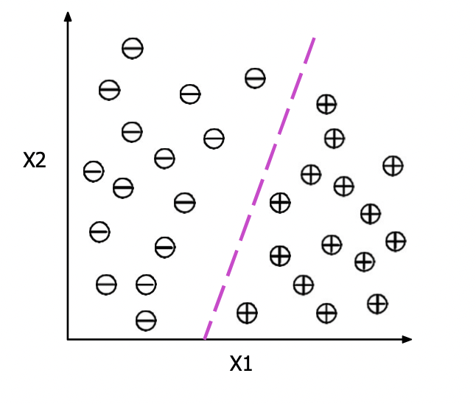
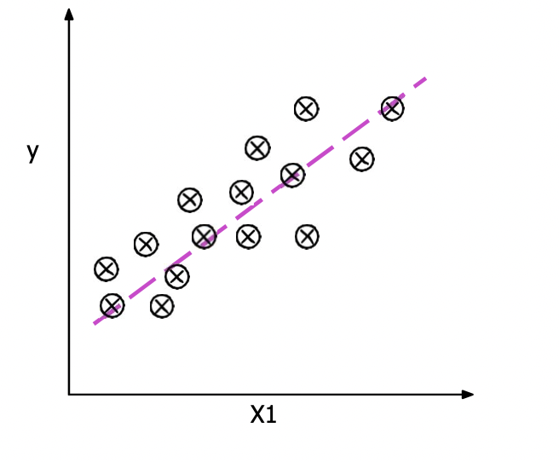
Chapter -3
Supervised Learning
Figure : Illustration of a binary classification problem (plus, minus) and two feature variable (x1and x2).
Figure : Illustration of a linear regression model with one feature variable (x1) and the target variable y. The dashed-line indica the functional form of the linear regression model.

Slide 10
Chapter -3
Unsupervised Learning
Unsupervised learning is a type of algorithm that learns patterns from untagged data. In other words we do not have labeled data and need to find the hidden patterns from the given dataset.
It is helpful for finding useful insights from the data.
Unsupervised learning is very much similar to our real life scenarios for example as a human learns to think by their own experiences, which makes it closer to the real world.
The goal of unsupervised learning is to filter data sets or group of data sets according to to similarities found in the give data.
Suppose the unsupervised learning algorithm is given an input dataset containing images of different types of parrots and pigeons. The algorithm is never trained upon the given dataset, which means it does not have any idea about the features of the dataset. The task of the unsupervised learning algorithm is to identify the image features on their own. Unsupervised learning algorithm will perform this task by clustering the image dataset into the groups according to similarities between images.

Slide 11

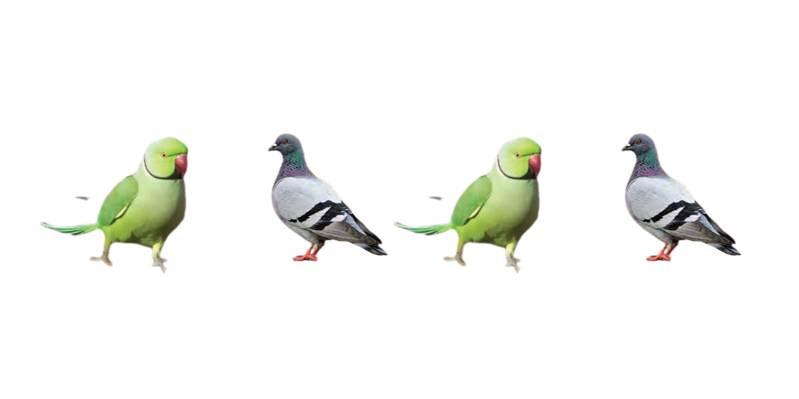
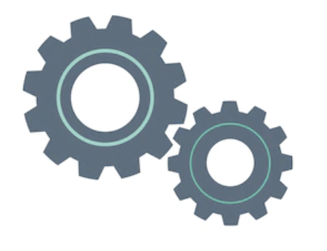
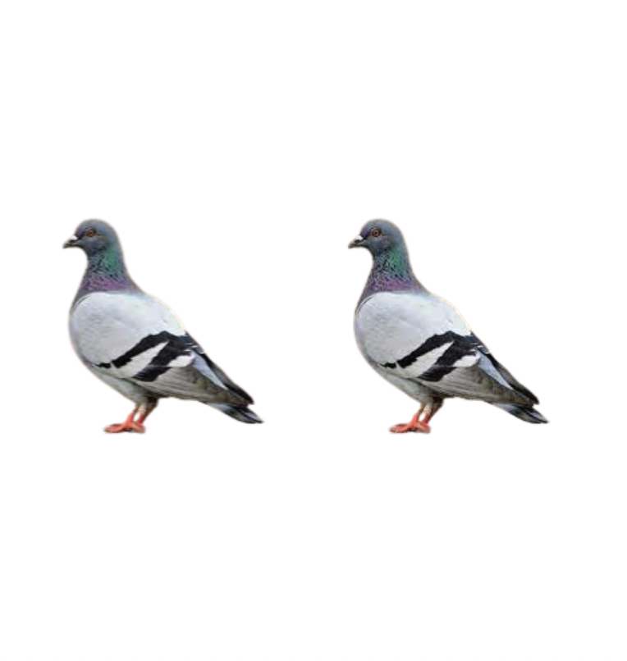
Chapter -3
Unsupervised Learning
Input Raw
( Unlabeled) Data
Output
Algorithm
…
…
…
...
Interpretation
Processing

Slide 12
Chapter -3
Reinforcement Learning
Reinforcement Learning (RL) is the science of decision making. It is about learning the optimal behavior in an environment to obtain maximum reward. In which we learned through interactions with the environment and observations from our nearby peoples, conversations, things near to us and how it responds, similar to student exploring the world around the school or university campus and learning from the activities that help them achieve a goal.

Slide 13
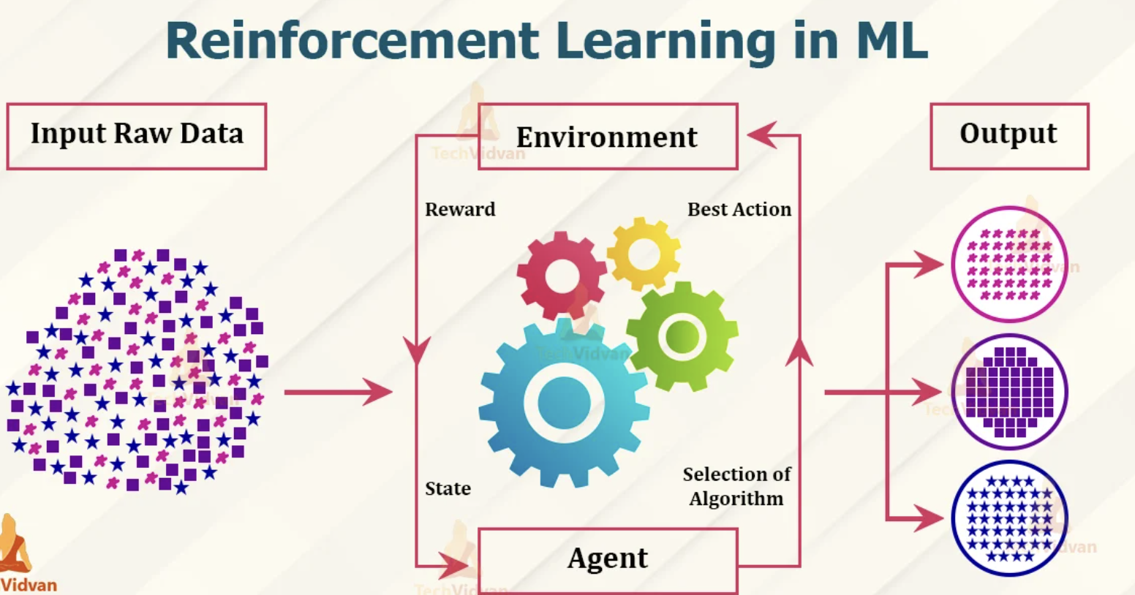
Chapter -3
Reinforcement Learning

Slide 14
Chapter -4
NumPy
What is NumPy ?
Numpy is scientific computing library for python.
Support large number of data in the form of multidimensional array and matrix.
Use for mathematics calculation like linear algebra, Fourier transform and random number capabilities.
NumPy for Machine Learning.
Machine learning not read direct images.
So convert images into array for read images.
Import Numpy
Import Numpy in Jupyter Notebook/Pycharm/VS code/Spyder
import numpy as np

Slide 15
Chapter -5
Pandas
What is pandas ?
pandas is a powerful python data analysis toolkit.
open source.
A fast and efficient Data frame object for data manipulation.
Reading and writing data structures and different formats : csv, tsv, txt, XML, JSON, ZIP etc.
Pandas vs Excel
Excel - fill missing data manually
Pandas - Fill millions of data using pandas
Pandas Data structure
Series - Single dimensional label data. Homogenous array.
datataframe - Two dimensional tabular format data. heterogenous array.
Panel - Three dimensional data

Slide 16
Chapter -5
Pandas
Pandas vs Numpy
Numpy array is used for the implementation of pandas data objects.
Installation of Pandas
pip install pandas
How to use pandas library
import pandas as pd
What is Pandas DataFrame ?
Pandas Dataframe is two-dimensional, Size-mutable , potentially heterogenous tabular data structure with labelled axis(rows & columns)

Slide 17
Chapter -6
Scikit – learn Library
What is Scikit – learn Library
Scikit-learn (Sklearn) is the most important and useful library for machine learning in Python.
It’s a Machine learning tool for statistical modeling including classification, regression, clustering and dimensionality reduction in python.
Instead of focusing on loading, manipulating and summarising data, Scikit-learn library is focused on modeling the data.
Almost all supervised, unsupervised learning and clustring algorithms are part of Scikit-learn.
Installation
If you already installed NumPy and Scipy, following are the two easiest ways to install scikit-learn
Installation Using conda
Following command can be used to install scikit-learn via conda −
conda install scikit-learn

Slide 18
Chapter -7
Concept of Machine Learning
Procedure of training ML model
Data acquiring: gather data from different source
Data preprocessing: process data so it can be applicable on ml algorithms
Define: What type of model will it be? A decision tree? Some other type of model? Some other parameters of the model type are specified too.
Fit: Capture patterns from provided data. This is the heart of modeling.
Predict: make multiple predication.
Evaluate: Determine how accurate the model's predictions are.

Slide 19
Chapter -7
Concept of Machine Learning
Training , test , validation
Training Dataset:- Training datasets are data that used to train our model.
Testing Dataset:- Testing dataset are the data on which model self evaluate it’s own performance.
Validation dataset:- This dataset are data that model has never seen before.
Training accuracy and validation accuracy
Training accuracy:- Training accuracy is accuracy that model acquire during training procedure and which obtain while self evaluation on test dataset.
Validation accuracy:- validation accuracy Is real accuracy in which we can say how our model perform in real world.

Slide 20
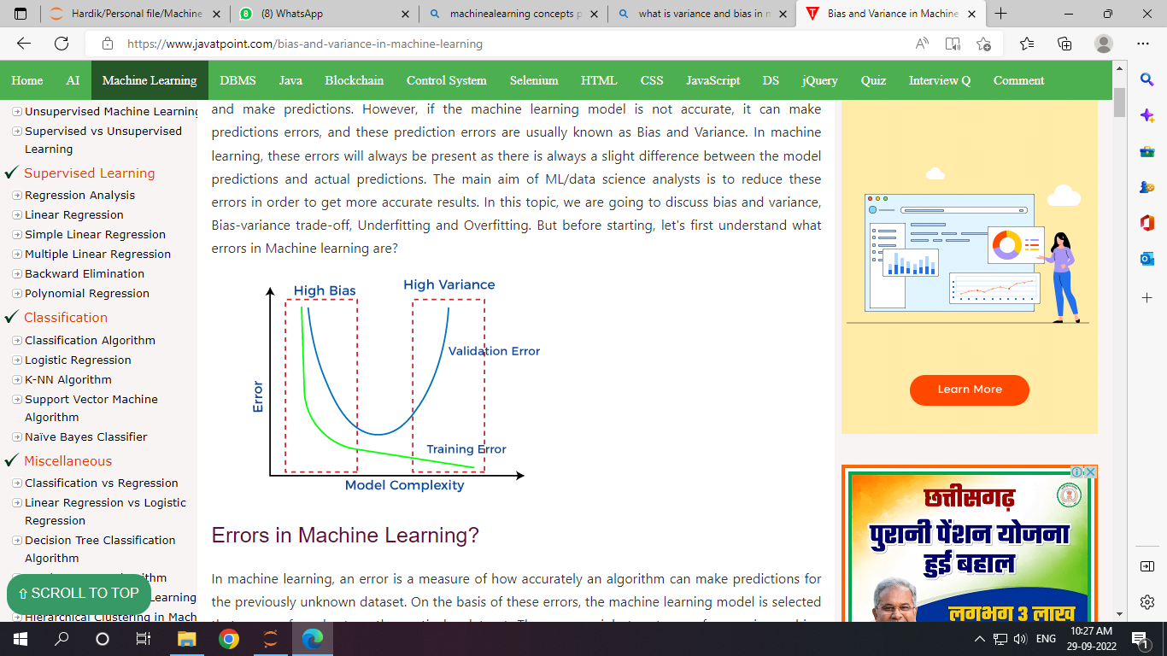
Chapter -7
Concept of Machine Learning
Overfitting and under fitting
Overfitting means our training has focused on the particular training set so much that it has missed the point entirely. In this way, the model is not able to adapt to new data as it’s too focused on the training set. (Train acc too high and val acc low)
Under fitting, on the other hand, means the model has not captured the underlying logic of the data. It doesn’t know what to do with the task we’ve given it and, therefore, provides an answer that is far from correct.(Train acc too low)
Variance and biased
Bias is considered a systematic error that occurs in the
machine learning model itself.
variance is the difference between the actual samples
of the dataset and the predictions made by the model.
correct assumptions in the ML process.

Slide 21
Chapter -9
Model Evolution in Machine Learning
It is the process of using different evaluation metrics to understand a machine learning model’s performance, as well as its strengths and weaknesses.
Machine learning models are designed to be able to give accurate predictions in order to create real value of predictions for a given organization.
We can check that how well is my model doing? Is it a useful model?
Will training my model on more data improve its performance?
Do I need to include more features?
We can use Different techniques to evaluate our model.

Slide 22
Chapter -8
Model Evolution - Classification
Classification
The confusion matrix shows a detailed breakdown of correct and incorrect classifications for each and every class. For example, the consequences of making a false positive or false negative in a skin disease diagnosis are very different.

Slide 23
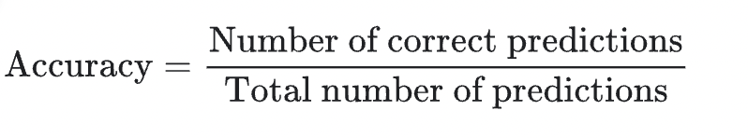
Chapter -8
Model Evolution - Classification
Classification
The metrics for measuring classification performance include accuracy, precision, confusion matrix, log-loss, and AUC (area under the ROC curve).
Accuracy is one metric for evaluating classification models. In other words accuracy is the fraction of predictions our model got right. Accuracy has the following definition:

Slide 24
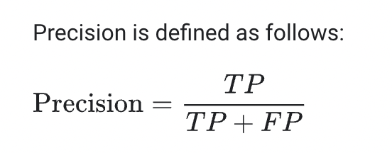
Chapter -8
Model Evolution - Classification
Classification
Precision measures the proportion of predicted Positives that are truly Positive. In a classification task, the precision for a class is the number of true positives (i.e. the number of items correctly labelled as belonging to the positive class) divided by the total number of elements labelled as belonging to the positive class (i.e. the sum of true positives and false positives)
Consider case of spam filter where number of false positive we need to reduce because important things should not be counted as spam.

Slide 25
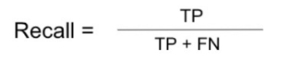
Chapter -8
Model Evolution - Classification
Classification
Recall The recall is calculated as the ratio between the numbers of Positive samples correctly classified as Positive to the total number of Positive samples. The recall measures the model's ability to detect positive samples.
Consider the scenario of cancer or heart disease prediction where we need to decrease number of false negative because unhealthy person classified healthy and it‘s health become more serious.so in such case recall is more important.

Slide 26
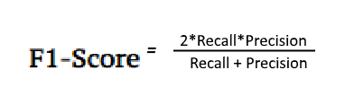
Chapter -8
Model Evolution - Classification
Classification
F1-score It is an evaluation metric for a classification defined as the harmonic mean of precision and recall. It is a statistical measure of the accuracy of a test or model.
It gives the combined information about the precision and recall of a model. This means a high F1-score indicates a high value for both recall and precision.

Slide 27
Chapter -9
Model Evolution - Regression
What is evaluation in regression?
A regression problem is about predicting a quantity. Evaluation metrics are a measure of how good a model performs and how well it approximates the relationship. To evaluate how good your regression model is, you can use below metrics.
R-squared: Indicate how many variables compared to the total variables in the predicted model.
Average error: the numerical difference between the predicted value and the actual value.
Median error: the average of all difference between the predicted and the actual values.
Average absolute error: similar to the average error.
Median absolute error: represents the average of the absolute differences between prediction and actual observation.

